Slide 1
Sexuality in Society and
Through the Lifespan
Michael McGee, PhD

Slide 2
What happens when?
(in our culture)
At what age is it okay to start having sex with another person?
At what age does the other sex have cooties?
What do kids (under 10) do sexually?
At what age do people stop having sex?

Slide 3

I. Infancy through adolescence
A. Infancy and childhood
  Sexuality has its roots in infancy; signs of physiological sexual response evident from birth
  Many children experiment with masturbation long before puberty
  It is not uncommon for pre-pubertal children to have experiences of a sexual nature with their peers
    Not indicative of adult sexual orientation

Slide 4

B. Puberty
Period of rapid physical changes that ultimately leads to sexual maturity
Typically begins between ages 10-12 for females, but sometimes occurs earlier or later
Surge of hormones leads to development of secondary sex characteristics, or physical indicators of sexual maturity
Menarche (first menstruation) or spermarche (production of sperm begins) eventually occurs

Slide 5
C. Adolescence
Puberty usually begins and ends during adolescence
First feelings of sexual attraction typically occur
  Age 10 on average for men and women regardless of sexual orientation
Process of sexual identity development begins
Sexual exploration with peers is common
  Partnered behaviors tend to follow a culture’s sexual script in terms of activity progression
https://youtu.be/gTmGzaUPmxQ

Slide 6

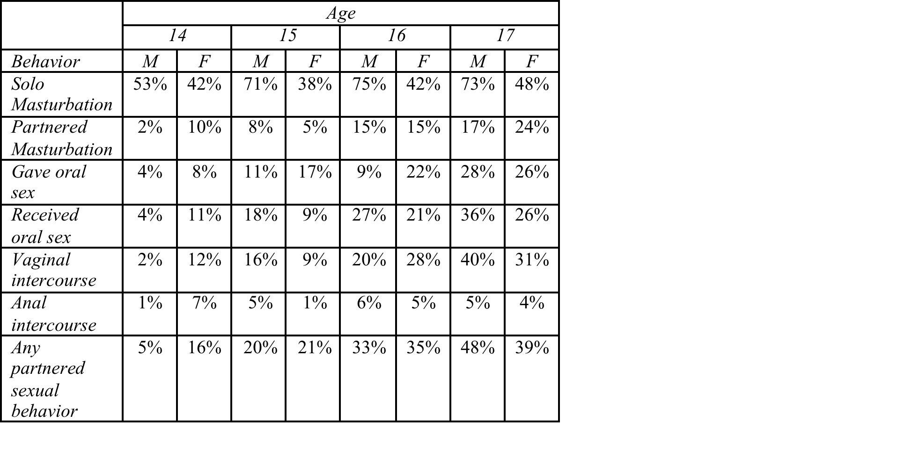
Sexual behaviors among adolescents aged 14-17 (Fortenberry et al., 2010)

Slide 7
Adolescence
In addition to the beginnings of sexual behavior, adolescence is when most have their first romantic relationship experiences
Teens’ sexual activity patterns are subject to biopsychosocial influences. Age of sexual debut linked to:
  Biological factors: age of puberty, certain disabilities
  Psychological factors: attachment anxiety, sensation seeking, attitudes toward sex
  Social factors: parent-child relationships, peer relationships, media and technology

Slide 8

Adolescence
Implications of early sexual development
  Less likely to use contraception, increased risk of STIs
  For girls, more depressive symptoms; however, this appears to be temporary and only prior to age 16
Implications of late sexual development
  More likely to experience sexual problems, particularly men
    But are sexual problems a cause or consequence or late sexual debut?
  Experiences with social stigma

Slide 9
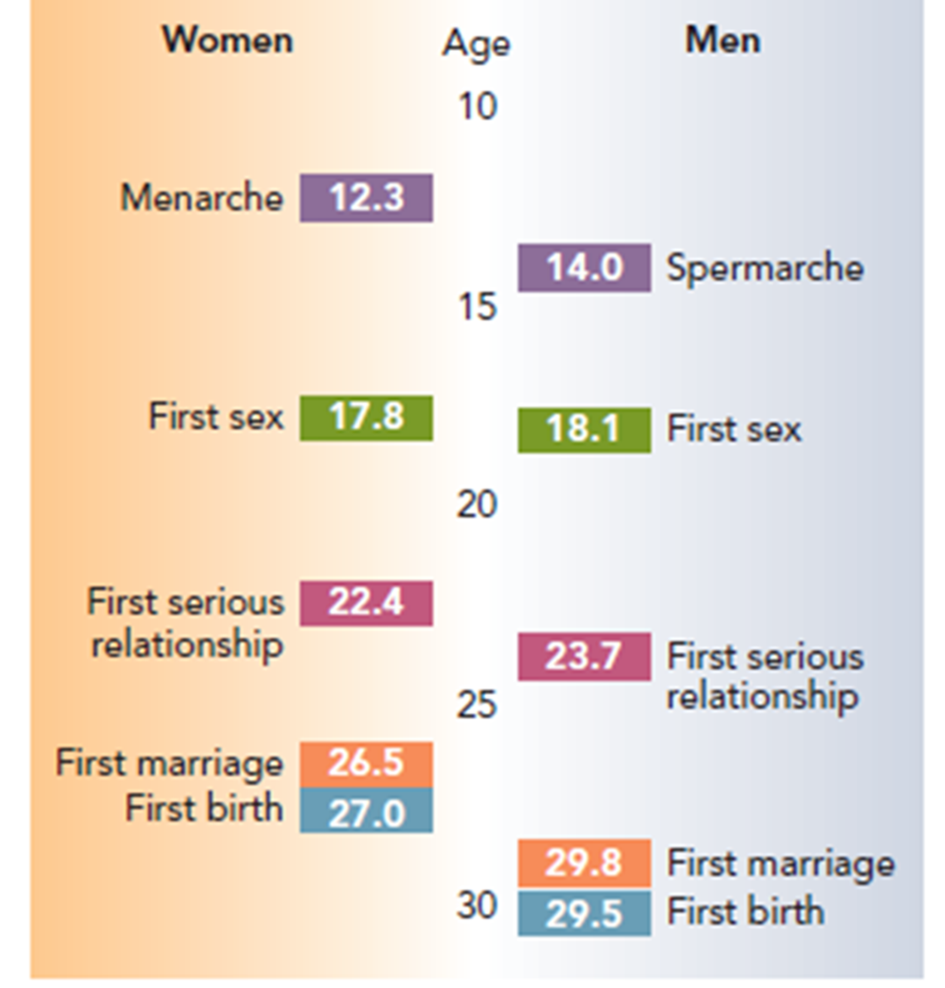

Slide 10

Parent-Child Communication About Sex

Slide 11
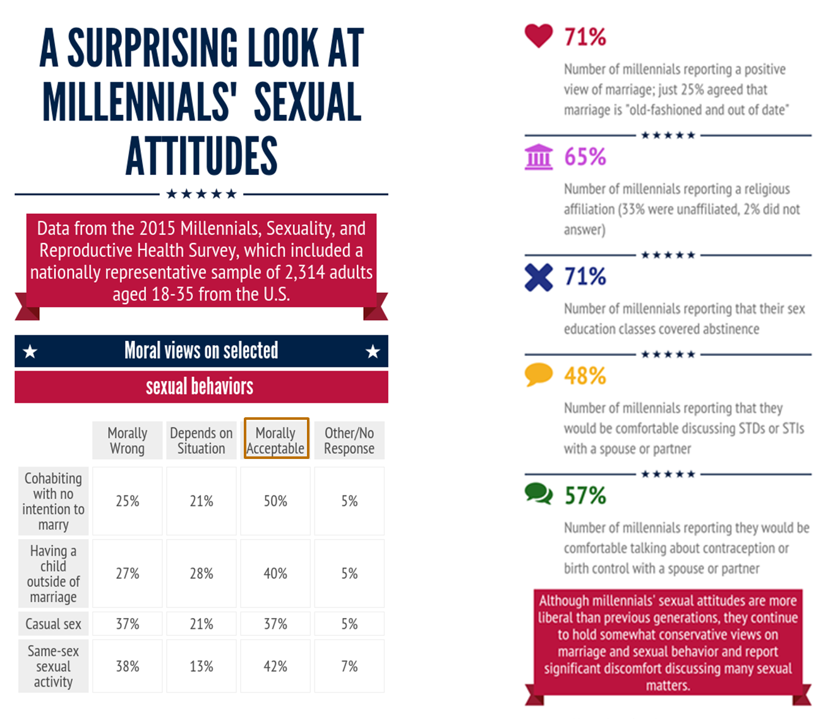

Slide 12
Patterns in Adult Partnerships
Sexual Satisfaction in Partnerships
  Sexual frequency does not usually correlate with satisfaction
    Frequency of sexual activity tends to be higher in the first two years of a relationship
    Frequency of sex depends on age, marital status, and gender
    Between 15-20% of married couples have sex 10 or fewer times per year
  Emotional ties and the effectiveness of their communication are very closely connected with the relationship’s sexual component

Slide 13

II. Sexuality and aging
Seniors stereotyped as “post-sexual”
The reality is that many seniors continue to have active sex lives; however, their sexual health needs are often ignored or go unaddressed
Little research has addressed sexuality among older adults, especially those who are gay, lesbian, or bisexual

Slide 14



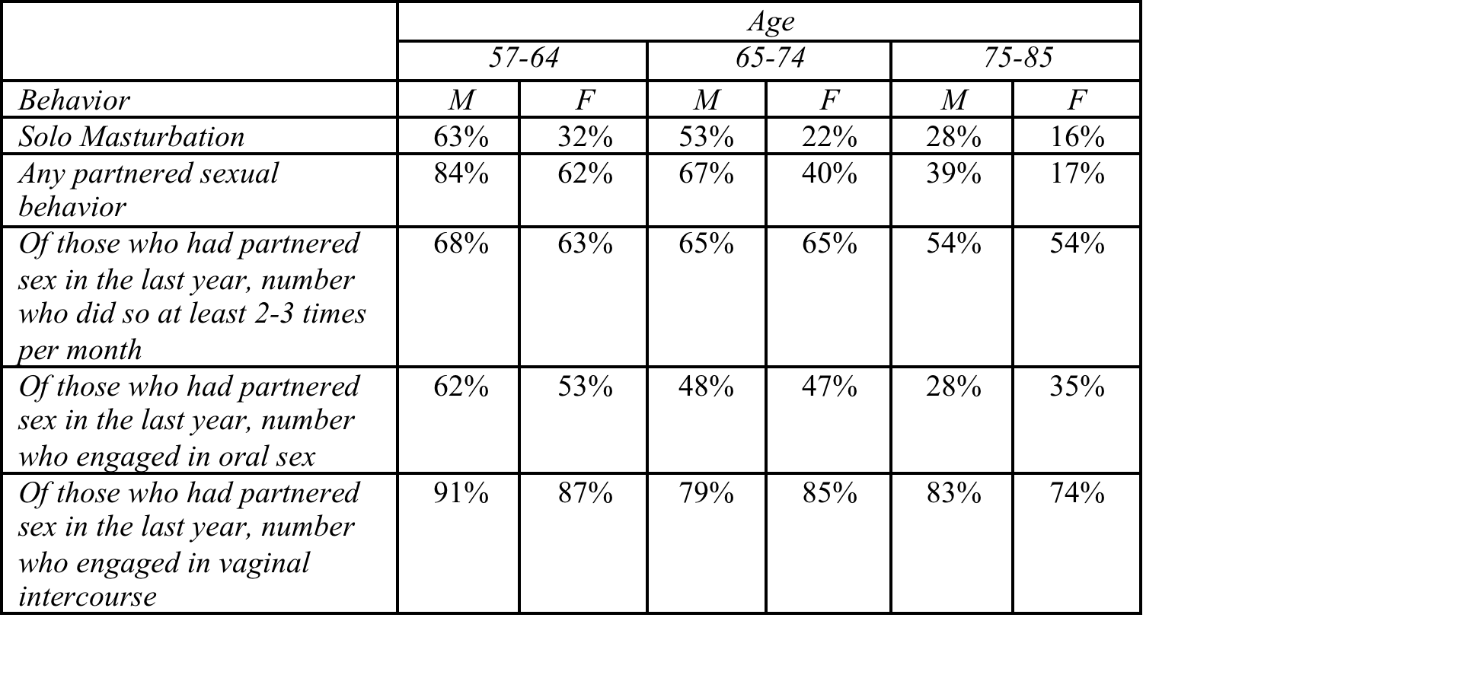
Sexual behaviors among older adults aged 57-85
(Lindau et al., 2007)

Slide 15
Sexuality and aging
Own and partner health are the biggest factors affecting older adults’ sex lives
Maintaining an active sex live may be good for seniors’ well-being
  A variety of studies suggest potential benefits of sex for physical health and cognitive functioning

Slide 16
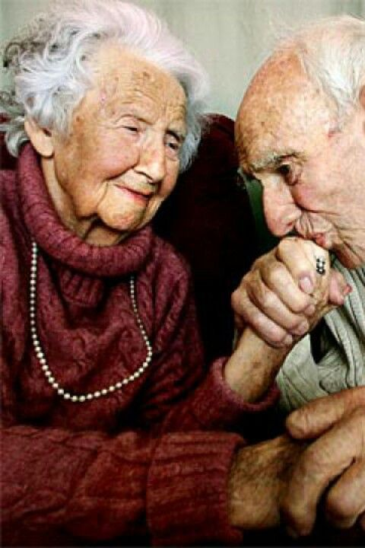
Aging and sexual satisfaction
Research suggests that a majority of older adults are sexually satisfied
However, what makes sex satisfying changes as we age, with quantity mattering less and quality mattering more

Slide 17
Sexuality and aging
Biopsychosocial influences on the sexual activities of older adults
  Biological factors: chronic health issues, menopause and other hormonal changes
  Psychological factors: diminished cognitive capacity due to dementia, illusion of safety due to lack of pregnancy concerns
  Social and environmental factors: relationship status (presence/absence of partner), rules/limits imposed by nursing homes and assisted living facilities

Slide 18
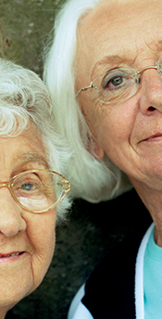
Diminished capacity and consent
There is an emerging debate over whether seniors who develop diminished capacity due to Alzheimer’s or dementia can consent to sex with a spouse
At what point, if any, does someone who develops diminished capacity lose the ability to offer consent? Who should decide this?

Slide 19
Questions and comments

